Slide 1
CHINESE REMAINDER THEOREM,
The Binomial Theorem
&
Linear Congruences

Slide 2
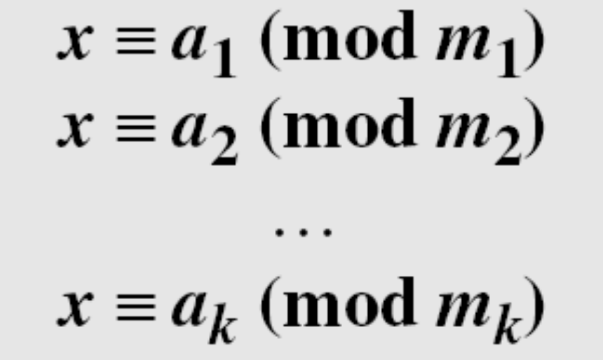
9-4 CHINESE REMAINDER THEOREM
The Chinese remainder theorem (CRT) is used to solve a set of congruent equations with one variable but different moduli, which are relatively prime, as shown
below:
9.<number>

Slide 3
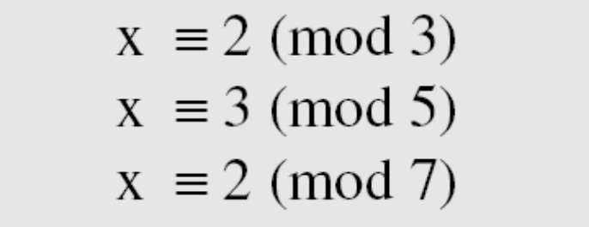
9-4 Continued
The following is an example of a set of equations with different moduli:
The solution to this set of equations is given in the next section; for the moment, note that the answer to this set of equations is x = 23. This value satisfies all equations: 23 ≡ 2 (mod 3), 23 ≡ 3 (mod 5), and 23 ≡ 2 (mod 7).
9.<number>

Slide 4
9-4 Continued
Solution To Chinese Remainder Theorem
1. Find M = m₁ × m₂ × … × m_{k}. This is the common modulus.
2. Find M₁ = M/m₁, M₂ = M/m₂, …, M_{k} = M/m_{k}.
3. Find the multiplicative inverse of M₁, M₂, …, M_{k} using the
corresponding moduli (m₁, m₂, …, m_{k}). Call the inverses
M₁⁻¹, M₂⁻¹, …, M_{k} ⁻¹.
4. The solution to the simultaneous equations is
9.<number>

Slide 5
9-4 Continued
Find the solution to the simultaneous equations:
Solution
We follow the four steps.
1. M = 3 × 5 × 7 = 105
2. M₁ = 105 / 3 = 35, M₂ = 105 / 5 = 21, M₃ = 105 / 7 = 15
3. The inverses are M₁⁻¹ = 2, M₂⁻¹ = 1, M₃ ⁻¹ = 1
4. x = (2 × 35 × 2 + 3 × 21 × 1 + 2 × 15 × 1) mod 105 = 23 mod 105
9.<number>

Slide 6
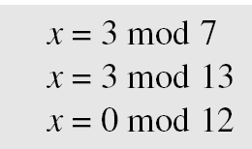
9-4 Continued
Find an integer that has a remainder of 3 when divided by 7 and 13, but is divisible by 12.
Solution
This is a CRT problem. We can form three equations and solve them to find the value of x.
If we follow the four steps, we find x = 276. We can check that
276 = 3 mod 7, 276 = 3 mod 13 and 276 is divisible by 12 (the quotient is 23 and the remainder is zero).
9.<number>

Slide 7
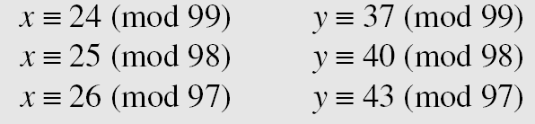
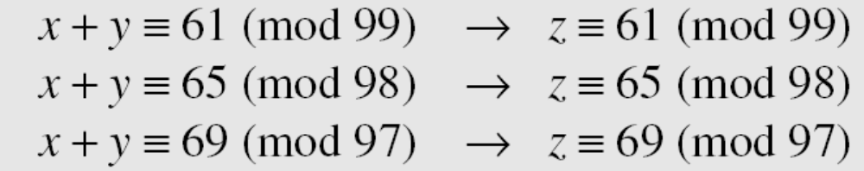
9-4 Continued
Assume we need to calculate z = x + y where x = 123 and y = 334, but our system accepts only numbers less than 100. These numbers can be represented as follows:
Adding each congruence in x with the corresponding congruence in y gives
Now three equations can be solved using the Chinese remainder theorem to find z. One of the acceptable answers is z = 457.
9.<number>

Slide 8
The Binomial Theorem

Slide 9
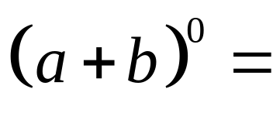

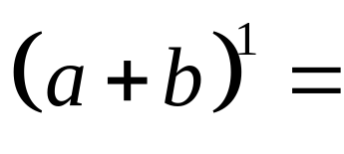
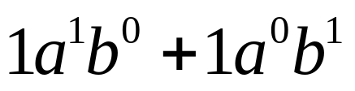
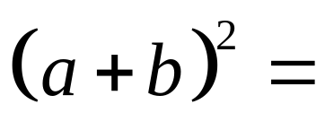
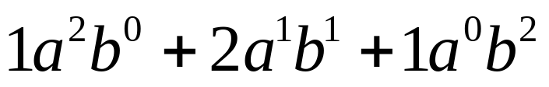
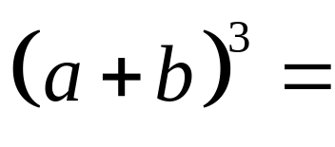
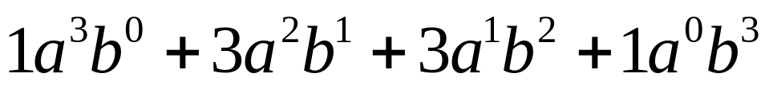
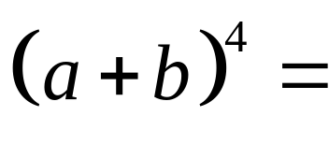

Powers of Binomials
n
Let’s expand (a + b) for n = 0, 1, 2, 3, 4, and 5:
Do you see a pattern with the binomial coefficients ???

Slide 10
Definition: Binomial Coefficient
The binomial coefficients that appear in the expansion
of (a + b) are the values of C for r = 0, 1, 2,…,n.
n
n
r
Recall that a classical notation for C (especially in
n
r
n
the context of binomial coefficients) is .
r
Both notations are read “n choose r.”

Slide 11
Finding Binomial Coefficients
5
Expand (a + b) , using a calculator to compute the
binomial coefficients.
Enter 5 C {0, 1, 2, 3, 4, 5} into your calculator…
n
r
The calculator returns the list {1, 5, 10, 10, 5, 1}…

Slide 12
Pascal’s Triangle
To obtain this famous figure, take only the positive coefficients
from the “triangular array” from our first example of the day:
1
Row 0
1
1
Row 1
1
2
1
1
3
3
1
1
4
6
4
1
1
5
10
10
5
1

Slide 13
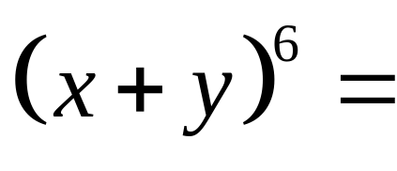
Extending Pascal’s Triangle
Show how row 5 of Pascal’s triangle can be used to obtain row 6,
and use the information to write the expansion of (x + y)
6
Row 4
1
4
6
4
1
The Pattern?
+
+
+
+
Row 5
1
5
10
10
5
1
+
+
+
+
+
Row 6
1
6
15
20
15
6
1

Slide 14
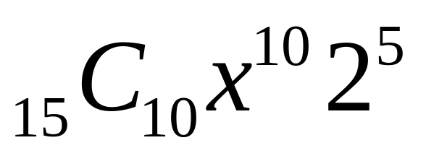
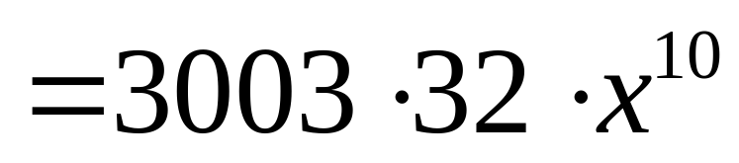
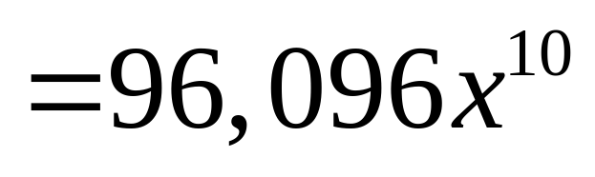
Finding Binomial Coefficients
10
15
Find the coefficient of x in the expansion of (x + 2) .
The only term we need:
The coefficient of x
10

Slide 15
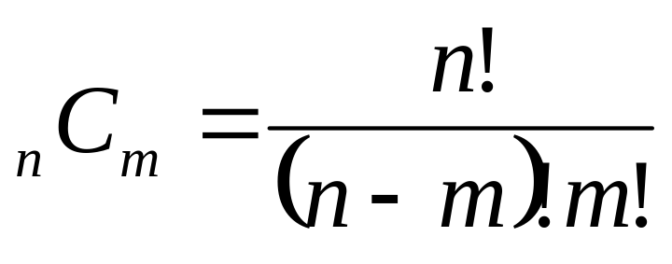
The Binomial Theorem
In the expansion of (x + y)^{n}
(x + y)^{n} = x^{n} + nx^{n-1}y + … + _{n}C_{m}x^{n-m}y^{m} + … +nxy^{n-1} + y^{n}
the coefficient of x^{n-m}y^{m} is given by

Slide 16
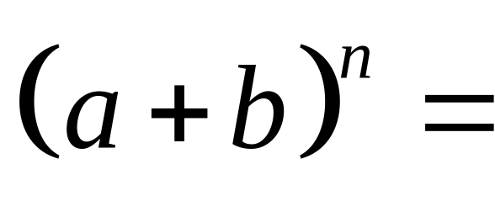
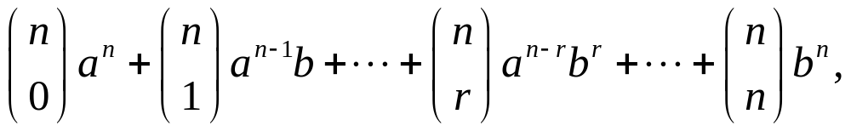
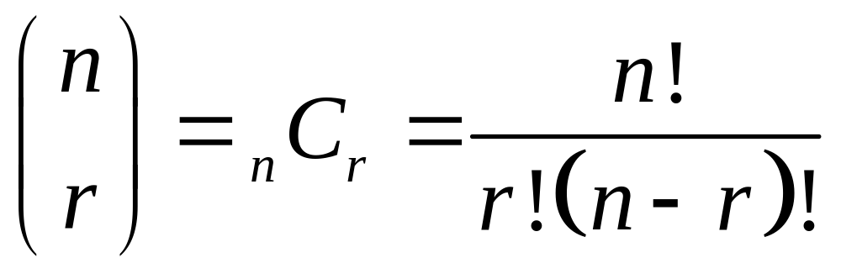
The Binomial Theorem
For any positive integer n,
where

Slide 17
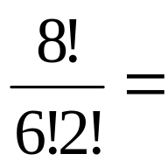
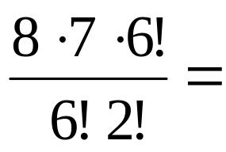
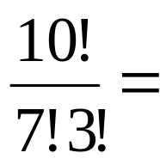
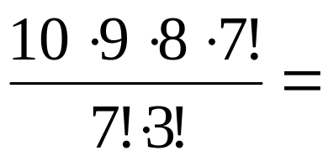
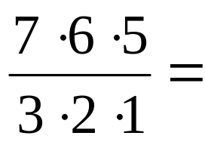
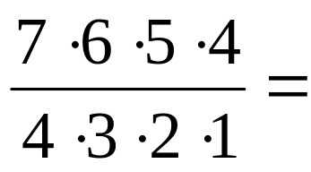
Find the following binomial coefficients.
₈C₂ =
28
₁₀C₃ =
120
₇C₃ =
35
₇C₄ =
35

Slide 18
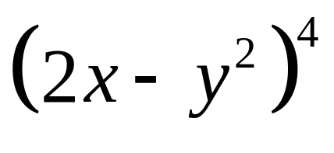
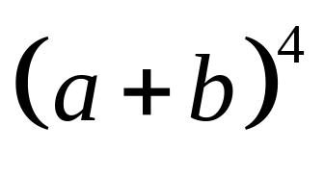
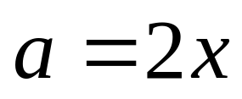
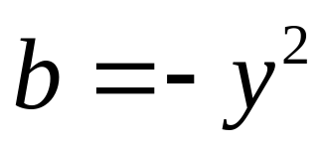
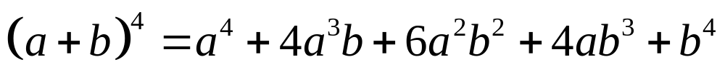
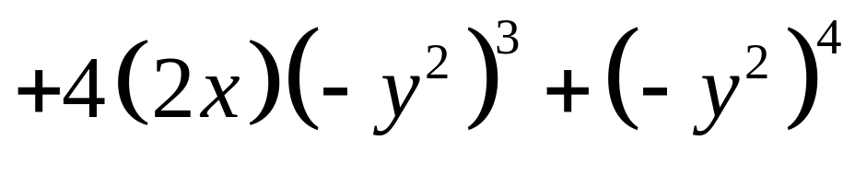
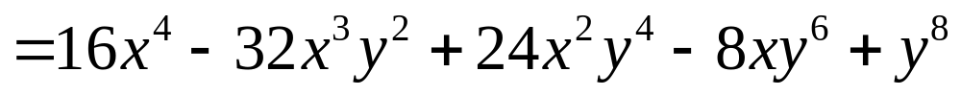
Using the Theorem
Expand
We expand
, with

Slide 19
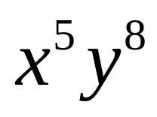
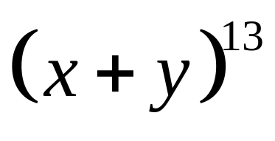
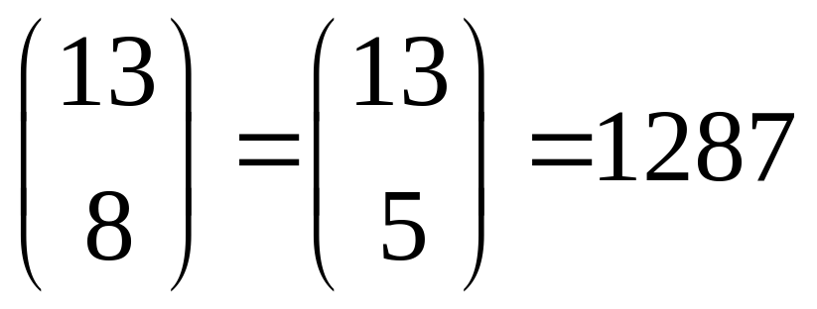
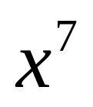
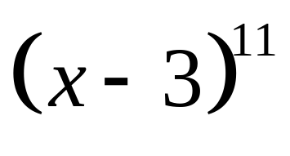
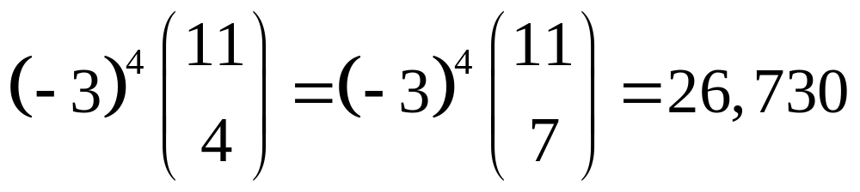
Guided Practice
Find the coefficient of the given term in the binomial expression.
Coefficient:
term,
term,
Coefficient:

Slide 20
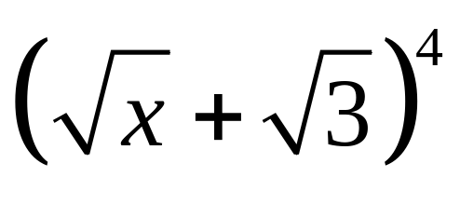

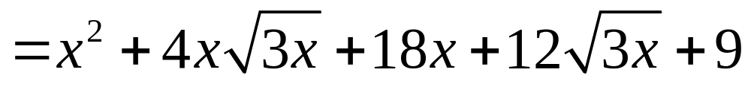
Guided Practice
Use the Binomial Theorem to expand

Slide 21
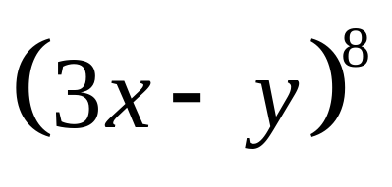
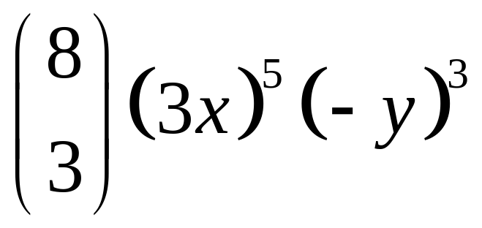
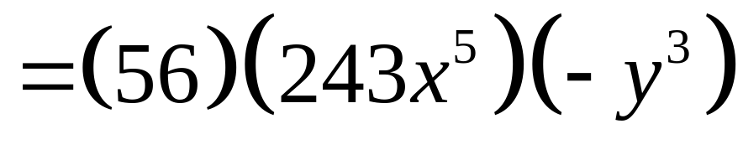
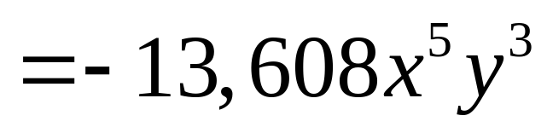
Guided Practice
Find the fourth term of
Fourth term:

Slide 22
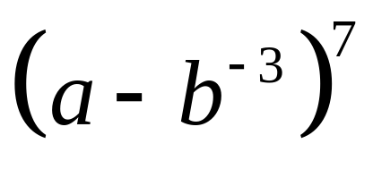
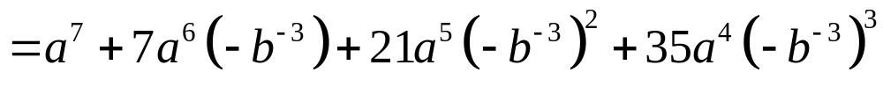
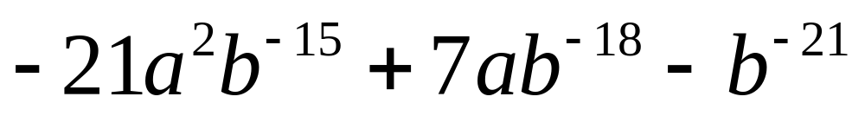
Guided Practice
Use the Binomial Theorem to expand

Slide 23
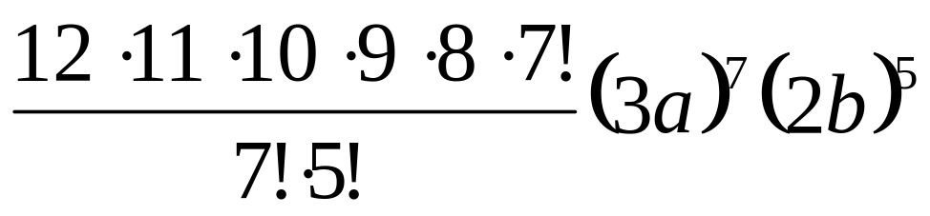

Find the 6th term in the expansion of (3a + 2b)¹²
Using the Binomial Theorem, let x = 3a and y = 2b
and note that in the 6th term, the exponent of y is
m = 5 and the exponent of x is n – m = 12 – 5 = 7.
Consequently, the 6th term of the expansion is:
= 55,427,328 a⁷b⁵

Slide 24
More on congruences
Theorem: Let a and b be integers, and let m be a positive integer. Then a ≡ b (mod m) if and only if a mod m = b mod m
Theorem:
Let m be a positive integer. The integers a and b are congruent modulo m if and only if there is an integer k such that a = b + km
Example: 17 and 5 are congruent modulo 6, so
  17 = 5 + 2*6
  5 = 17 - 2*6

Slide 25
Even even more on congruence
Theorem: Let m be a positive integer. If a ≡ b (mod m) and c ≡ d (mod m),
then a+c ≡ (b+d) (mod m) and ac ≡ bd (mod m)
Example
  We know that 7 ≡ 2 (mod 5) and 11 ≡ 1 (mod 5)
  Thus, 7+11 ≡ (2+1) (mod 5), or 18 ≡ 3 (mod 5)
  Thus, 7*11 ≡ 2*1 (mod 5), or 77 ≡ 2 (mod 5)

Slide 26
Applications of Congruences

Slide 27
Hashing Functions
Also known as:
  hash functions, hash codes, or just hashes.
Two major uses:
  Indexing hash tables
    Data structures which support O(1)-time access.
  Creating short unique IDs for long documents.
    Used in digital signatures – the short ID can be signed, rather than the long document.

Slide 28

Hash Functions
Example: Consider a a record that is identified by the SSN (9 digits) of the customer or customer name itself (mapped into binary number).
How can we assign a memory location to a record so that later on it’s easy to locate and retrieve such a record?
Solution to this problem → a good hashing function.
Records are identified using a key (k), which uniquely identifies each record.
If you compute the hash of the same data at different times, you should get the same answer – if not then the data has been modified.

Slide 29
Hash Function Requirements
A hash function h: A→B is a map from a set A to a smaller set B
(i.e., |A| ≥ |B|).
An effective hash function should have the following properties:
  It should cover (be onto) its codomain B.
  It should be efficient to calculate.
  The cardinality of each pre-image of an element of B should be about the same.
    ∀b₁,b₂∈B: |h⁻¹(b₁)| ≈ |h⁻¹(b₂)|
    That is, elements of B should be generated with roughly uniform probability.
  Ideally, the map should appear random, so that clearly “similar” elements of A are not likely to map to the same (or similar) elements of B.

Slide 30
Why are these important?
To make computations fast and efficient.
So that any message can be hashed.
To prevent a message being replaced with another with the same hash value.
To prevent the sender claiming to have sent x₂ when in fact the message was x_{1.}

Slide 31
Hash Function Requirements
Furthermore, for a cryptographically secure hash function:
  Given an element b∈B, the problem of finding an a∈A such that h(a)=b should have average-case time complexity of Ω(|B|^{c}) for some c>0.
    This ensures that it would take exponential time in the length of an ID for an opponent to “fake” a different document having the same ID.

Slide 32
A Simple Hash Using mod
Let the domain and codomain be the sets of all natural numbers below certain bounds:
  A = {a∈N | a < a_{lim}}, B = {b∈N | b < b_{lim}}
Then an acceptable (although not great!) hash function from A to B (when a_{lim}≥b_{lim}) is
h(a) = a mod b_{lim}.
It has the following desirable hash function properties:
  It covers or is onto its codomain B (its range is B).
  When a_{lim} ≫ b_{lim}, then each b∈B has a preimage of about the same size,
    Specifically, |h⁻¹(b)| = ⎣a_{lim}/b_{lim}⎦ or ⎡a_{lim}/b_{lim}⎤.

Slide 33
A Simple Hash Using mod
  However, it has the following limitations:
    It is not very random. Why not?
    It is definitely not cryptographically secure.
      Given a b, it is easy to generate a’s that map to it. How?
For example, if all a’s encountered happen to have the same residue mod b_{lim}, they will all map to the same b!
(see also “spiral view”) But ok, if input data is uniformly distributed.
        We know that for any n∈N, h(b + n b_{lim}) = b.

